Slide 1
Online Learning website
This is online platform for students and institute.
This platform can connect student to institute directly.
The idea is simple here are 3 type of people can login admin,institute,student.
Student can login,can add institute,can see institute wise subject list,can see video list,can see video,can see notice,can create to-do list.

Slide 2
Institute can login,can approved/reject student request,can see all student list,can see his video,can create notice for students.
Admin can add all master(subject,standard,topics...),can add all address(country,state,tehsil,…),can approved/reject institute,all see all institute list,can upload videos institute wise.

Slide 3
Backend:Asp.net
Database:Mysql
Front-end : Html,Css,Js,Bootstrap

Slide 4
User

Slide 5
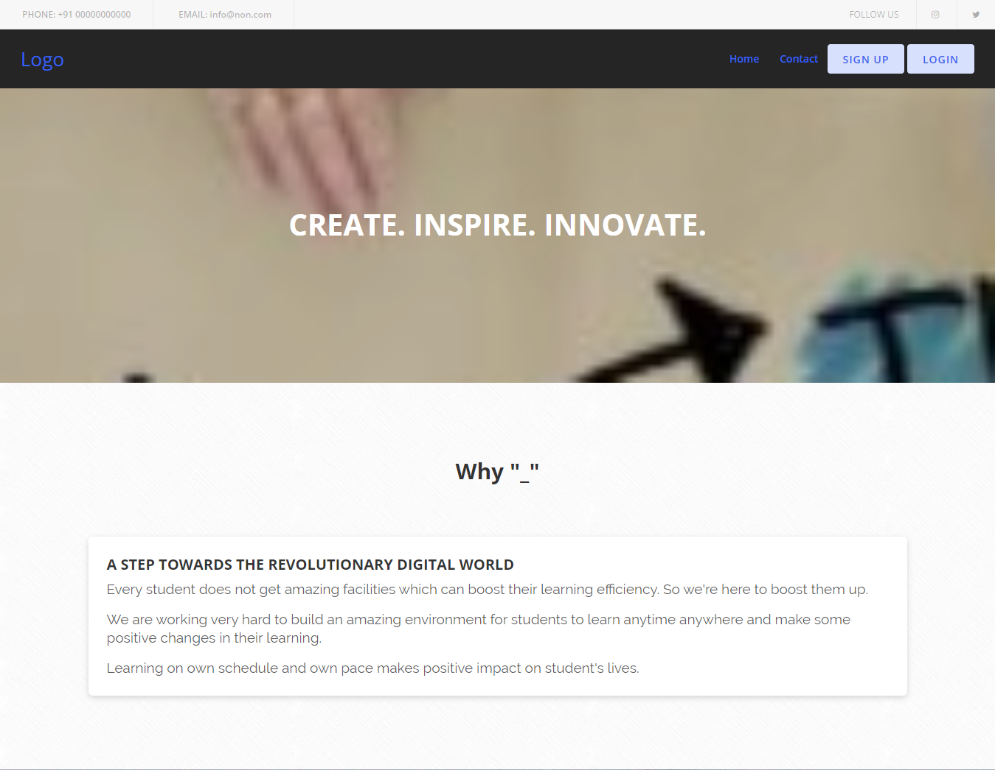
Index :

Slide 6
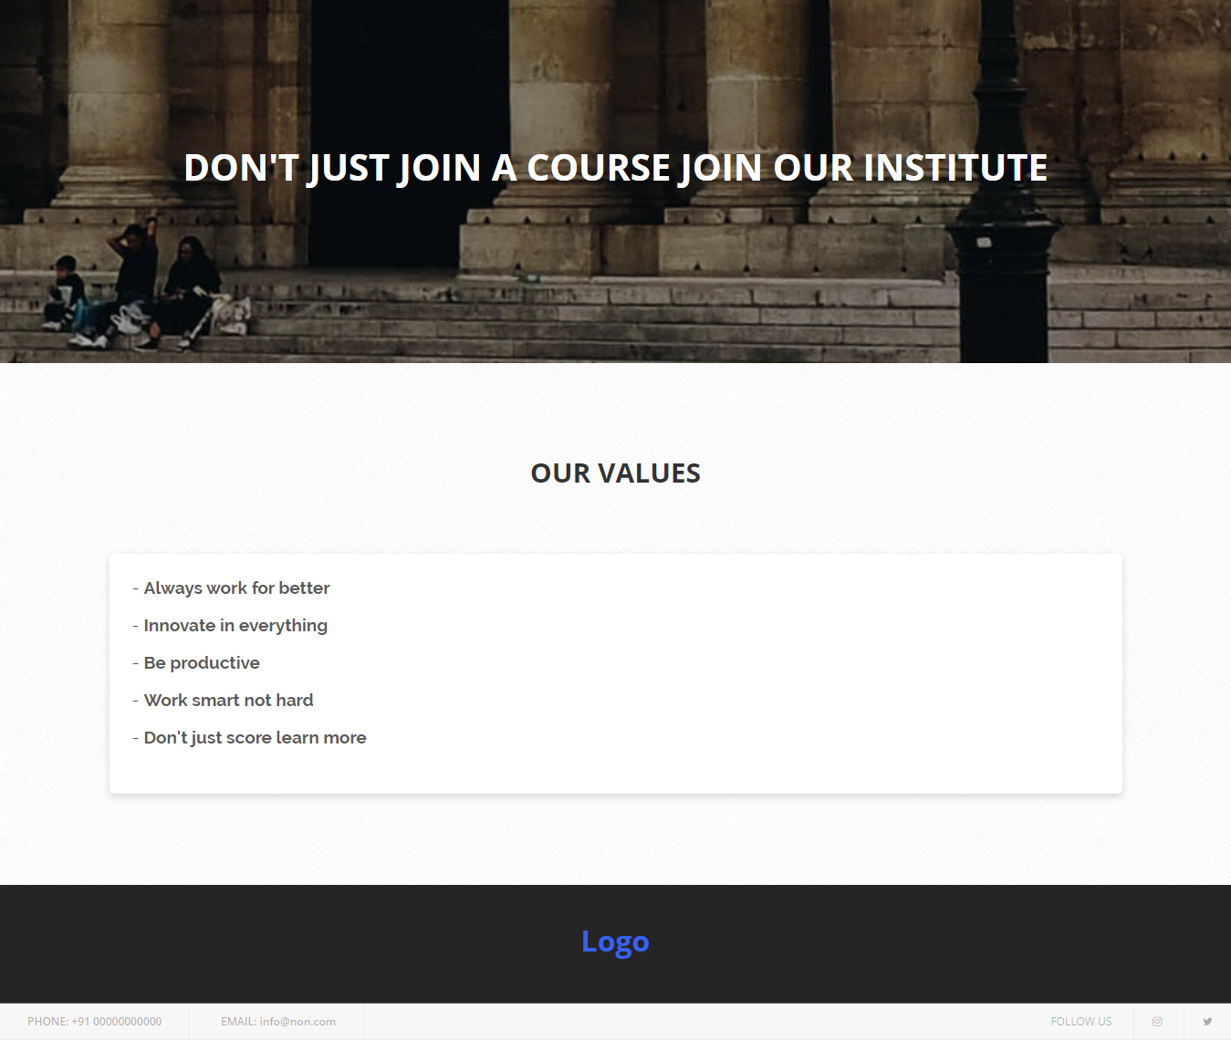

Slide 7
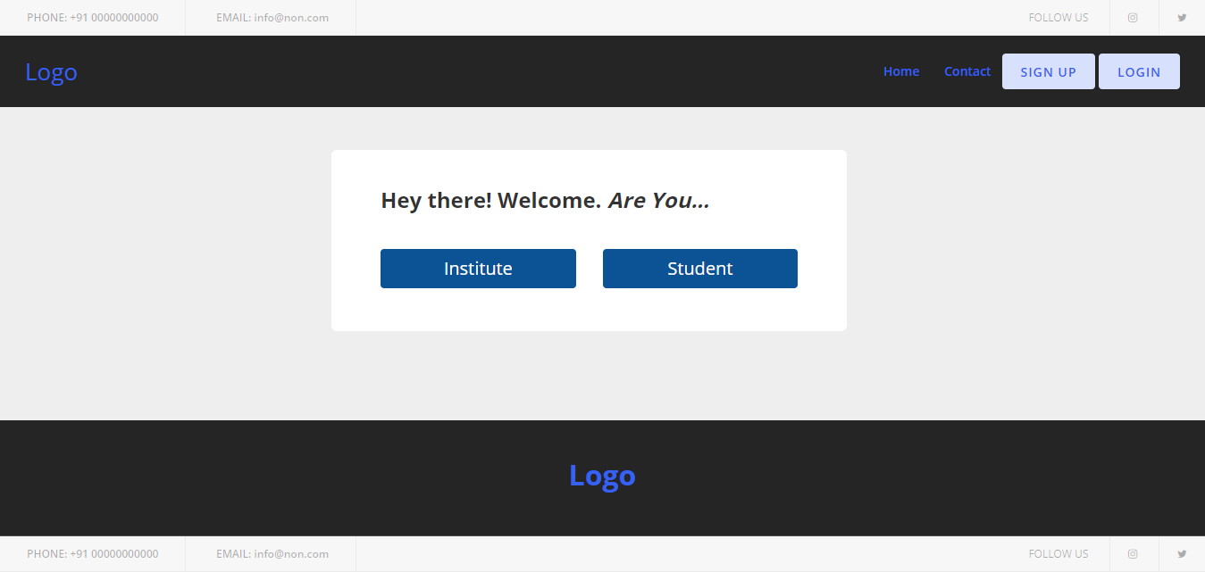
Select Registration Type :-
You can registration as institute or student.

Slide 8
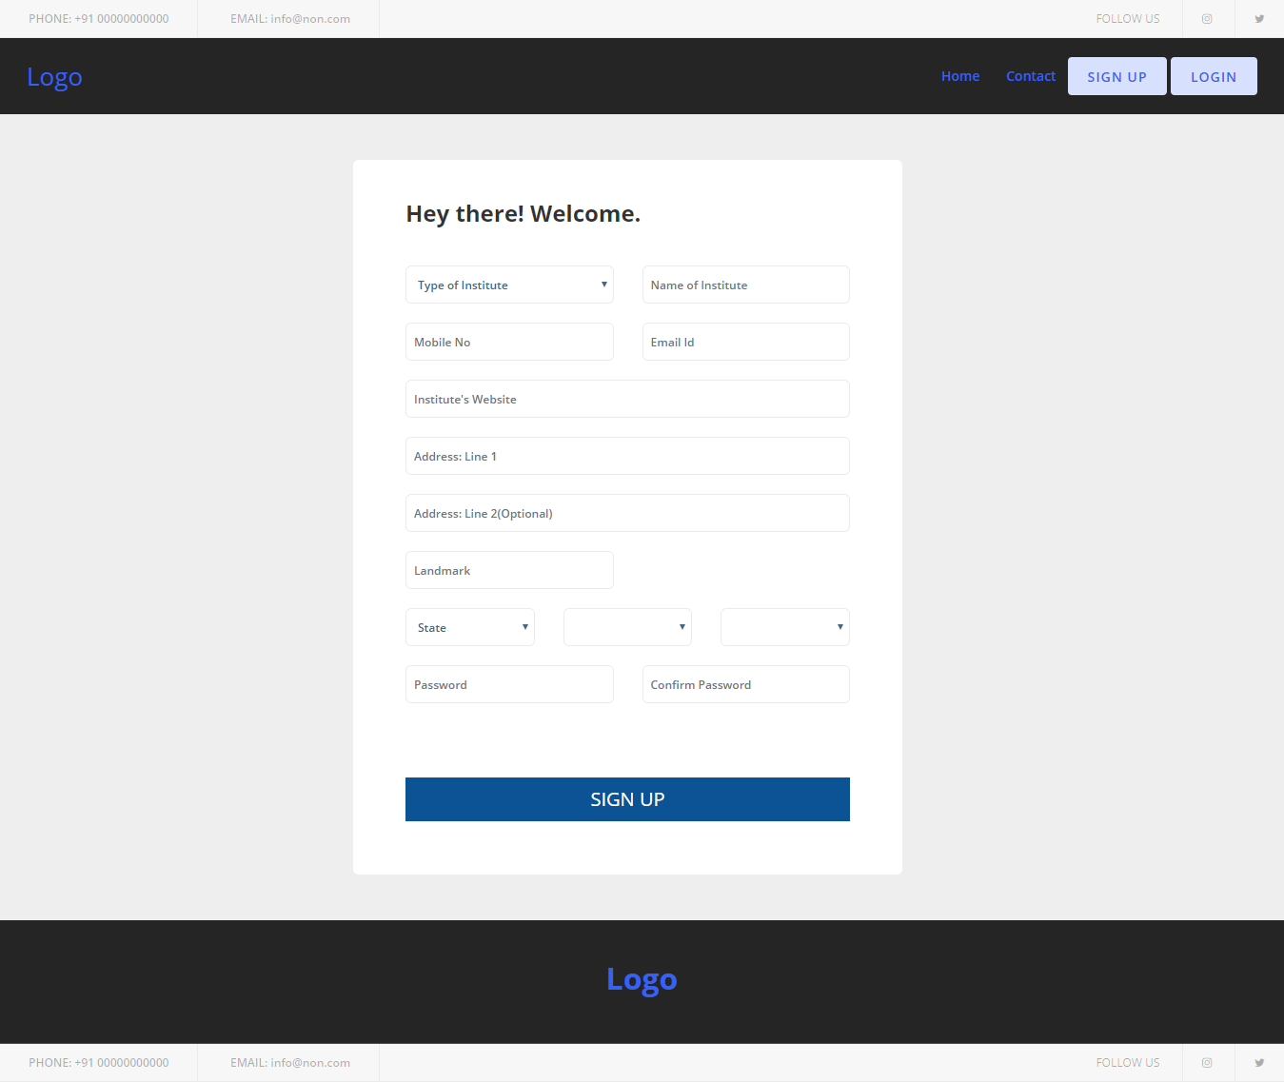
Institute Registration:-
After registration as institute you can go to your dashboard using this link.
Youlocalhost:/Institute/institute_login.aspx

Slide 9
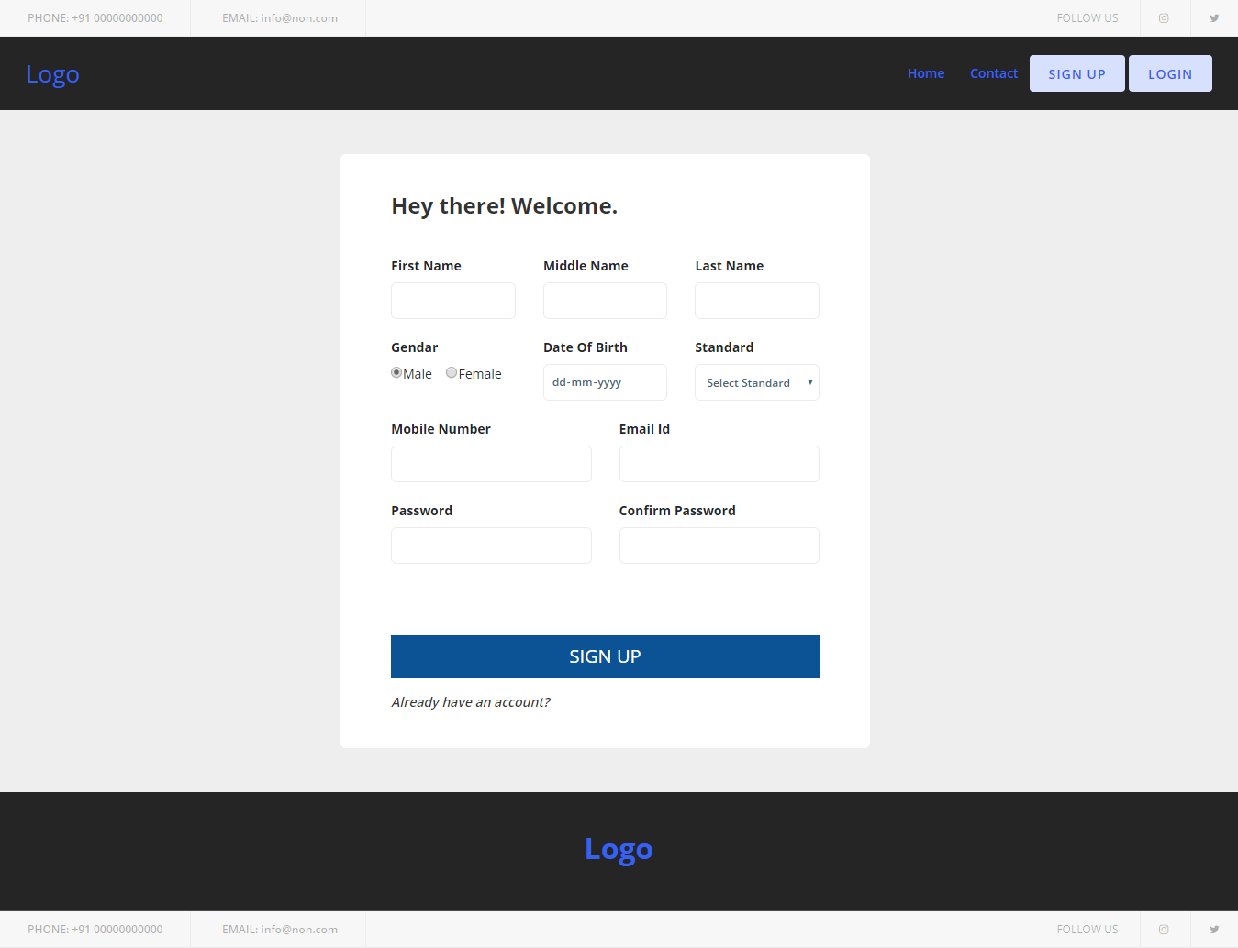
Student Registration -:

Slide 10
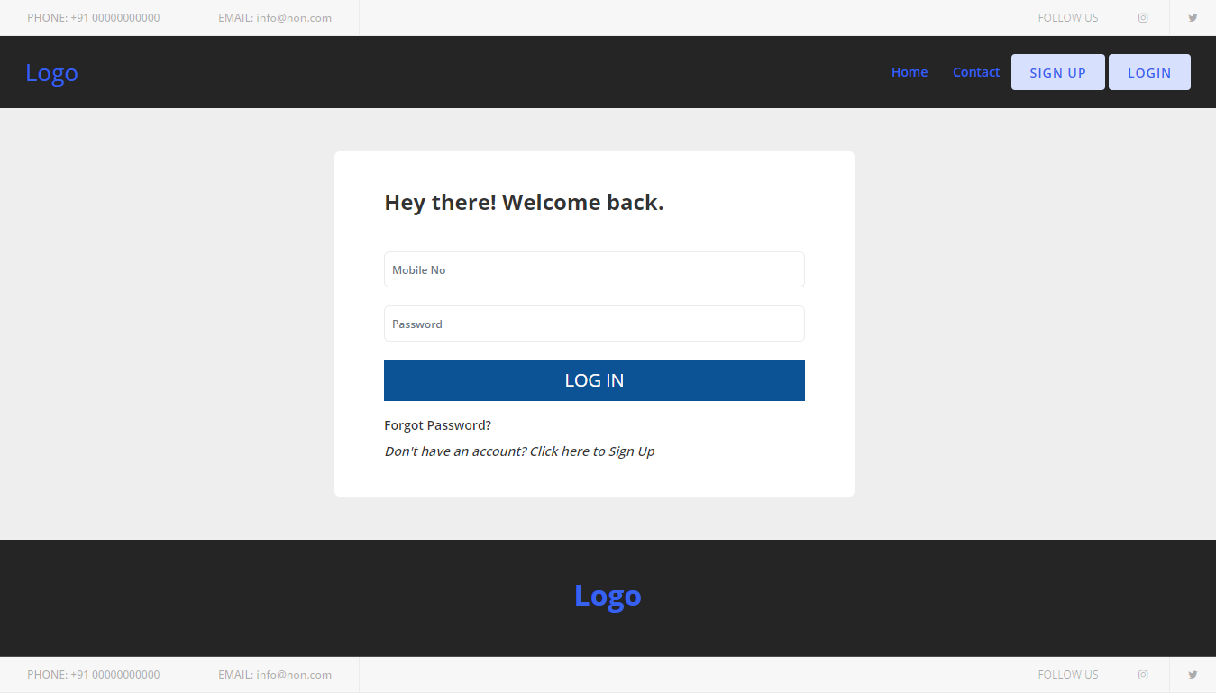
Student Login -:

Slide 11
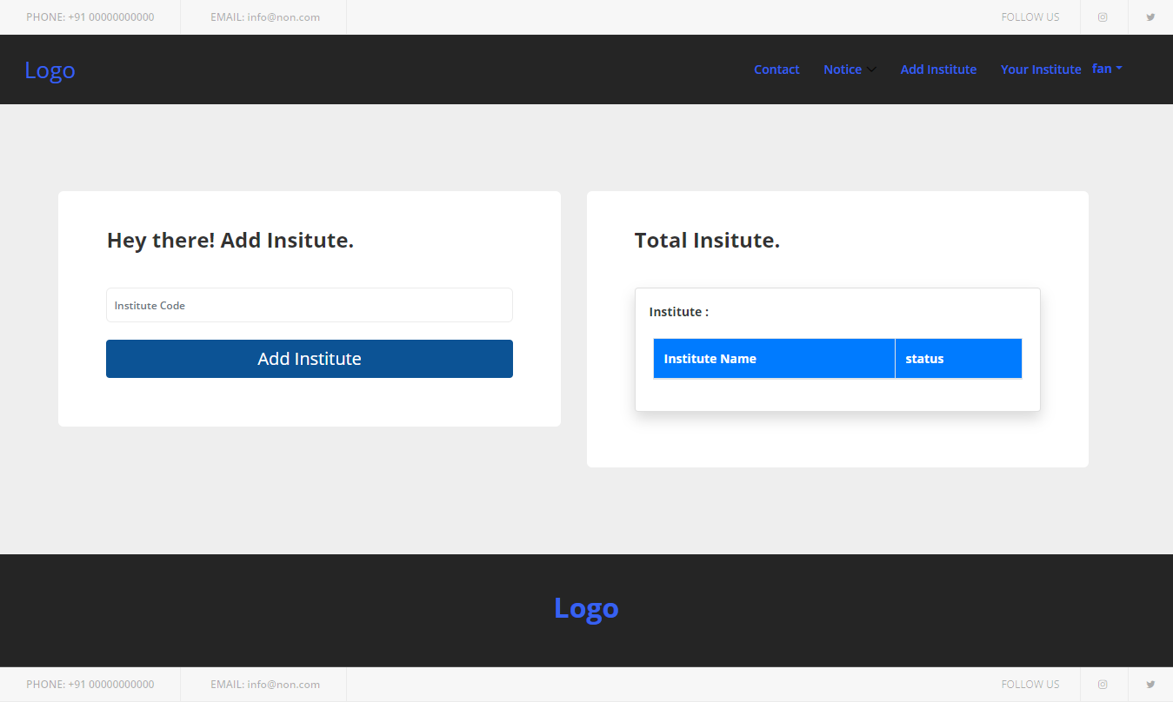
Institute Add -:
You can add you institute when Institute approved you.

Slide 12
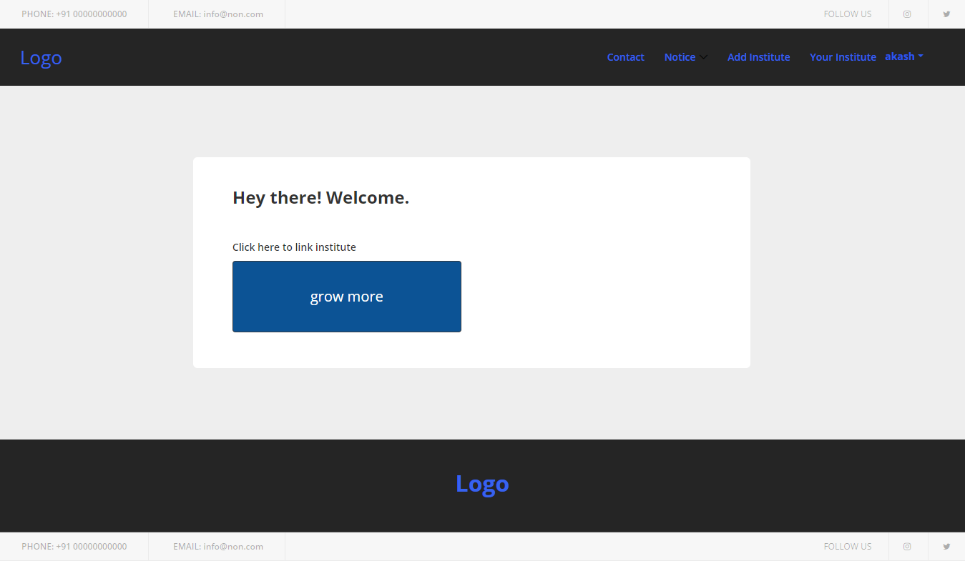
Student Institutes list -:
List of the institutes which students added.

Slide 13
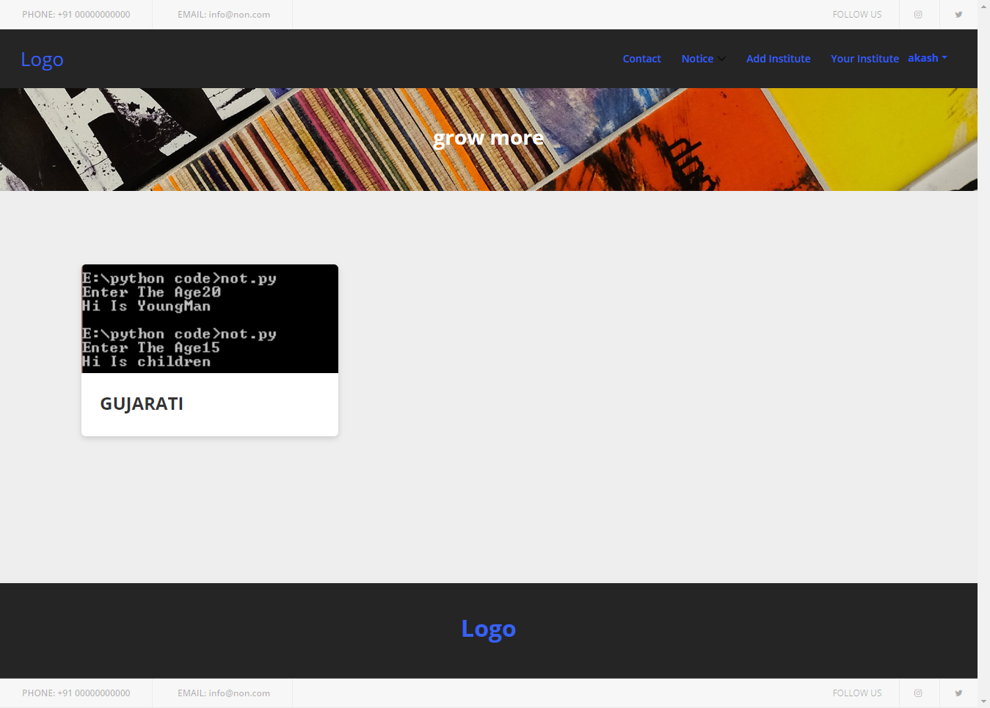
Institute Subject -:
List of the subject that institute provides.

Slide 14
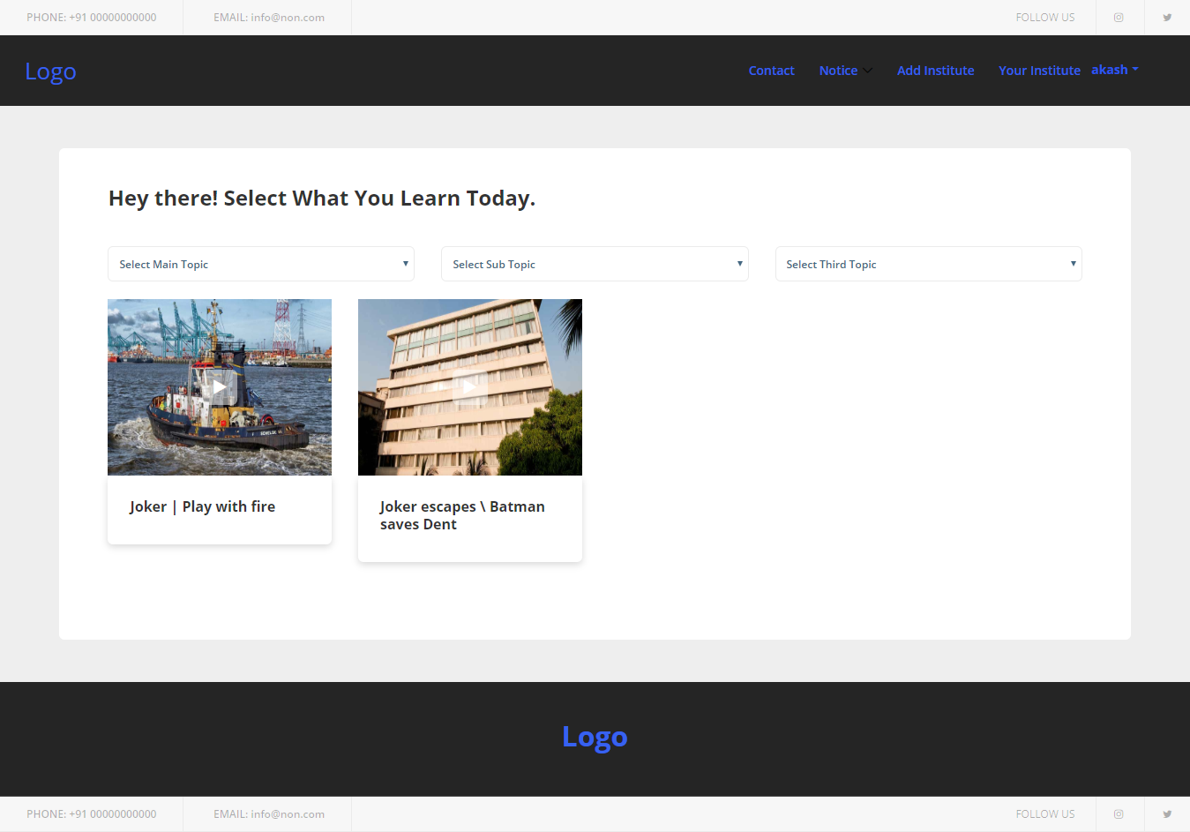
Video List -:
List of the videos that one institute provides.(subject wise)

Slide 15
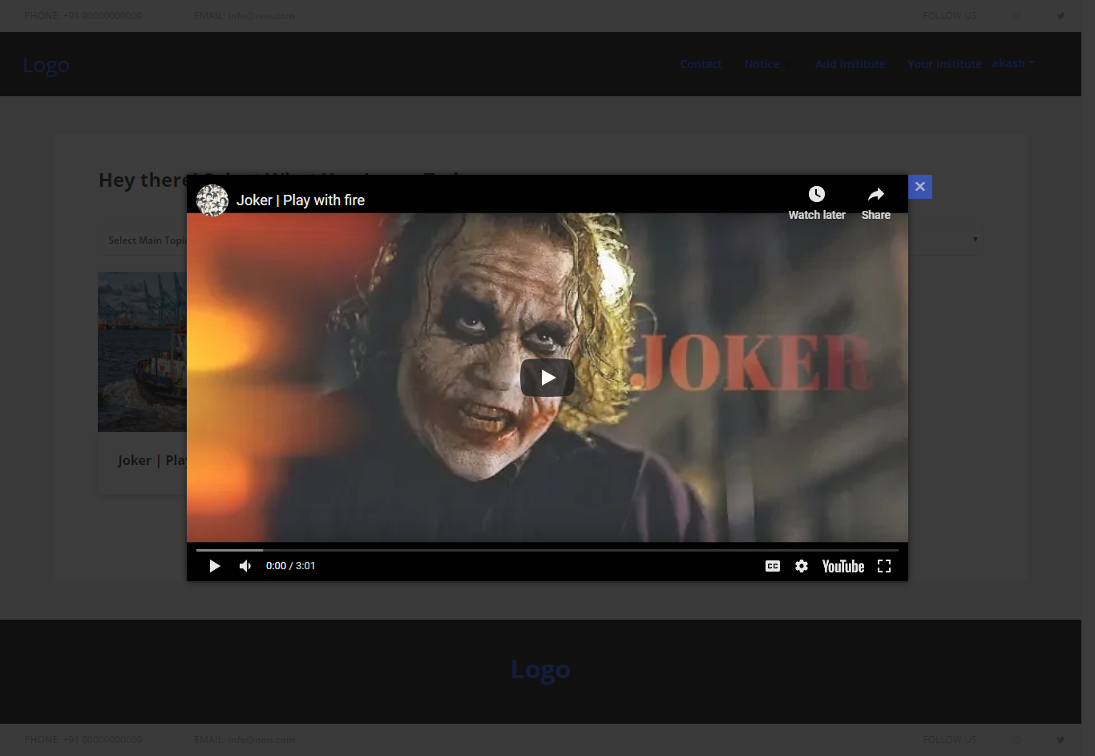
Video Show -:

Slide 16
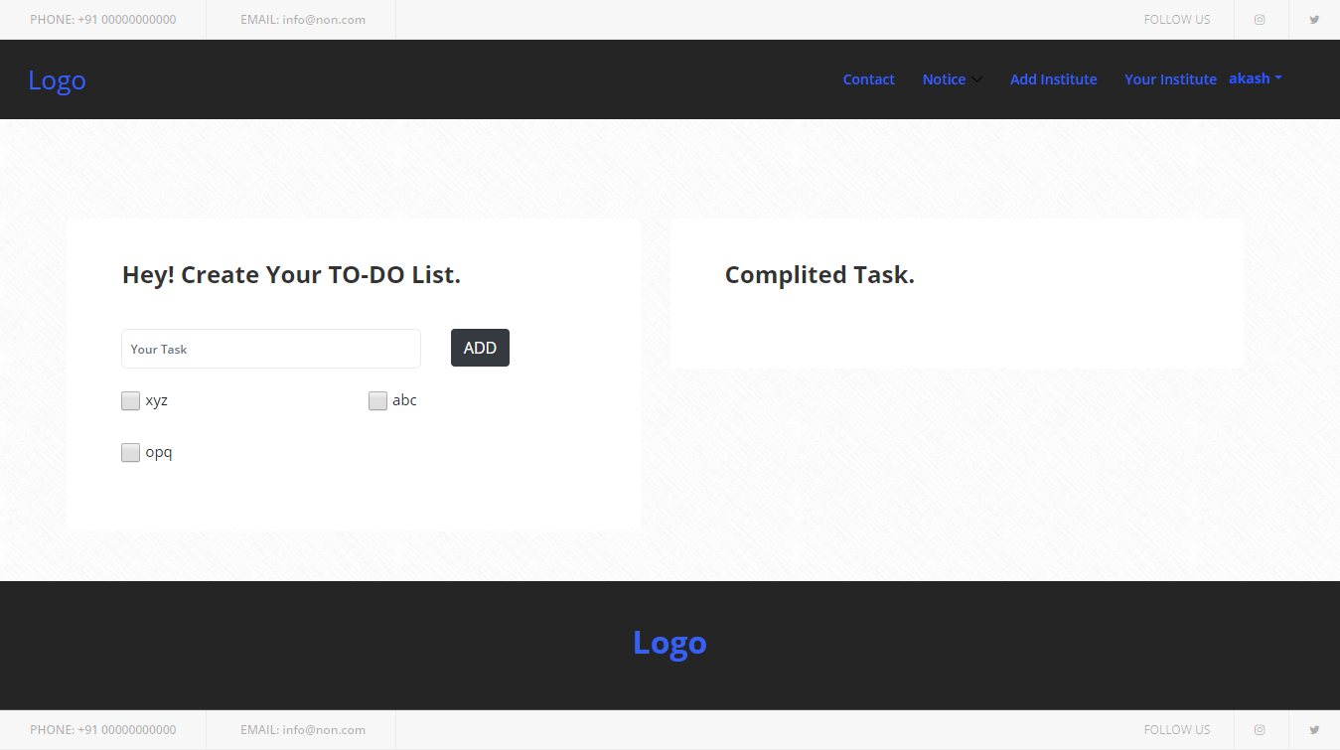
Task Add -:
To-do list which student can created for him self.

Slide 17
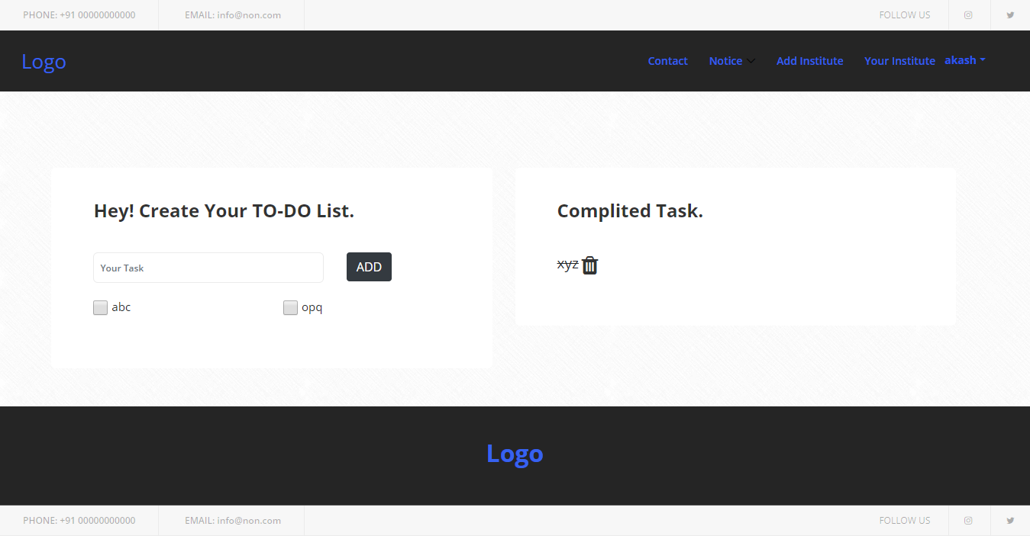
Complicated Task -:
By clicking on check box it counts as completed task.

Slide 18
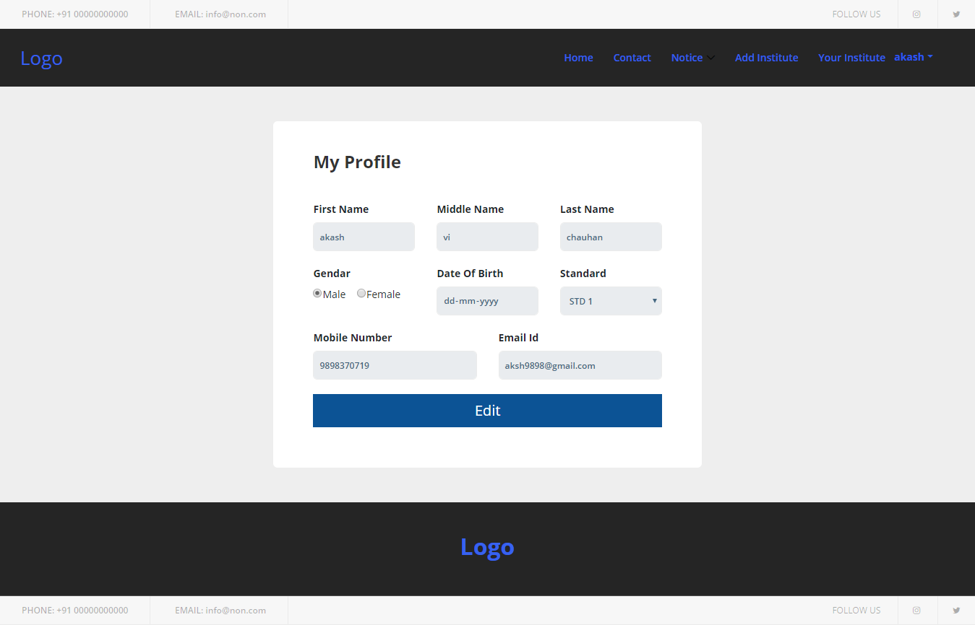
User profile -:

Slide 19
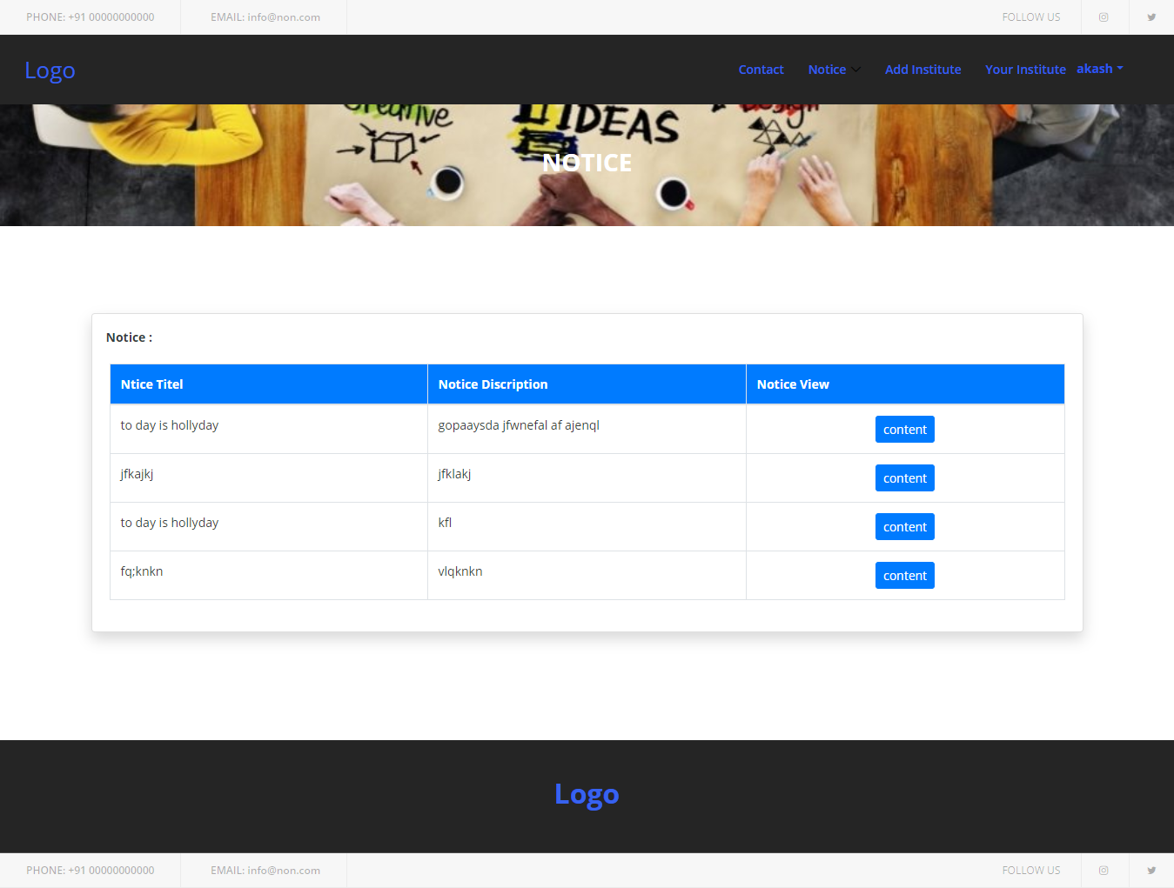
Notice List (Institute wise)-:

Slide 20
Institute

Slide 21
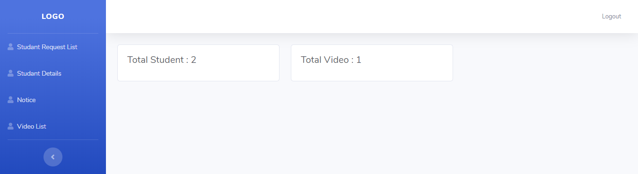
Institute Dashboard -:

Slide 22
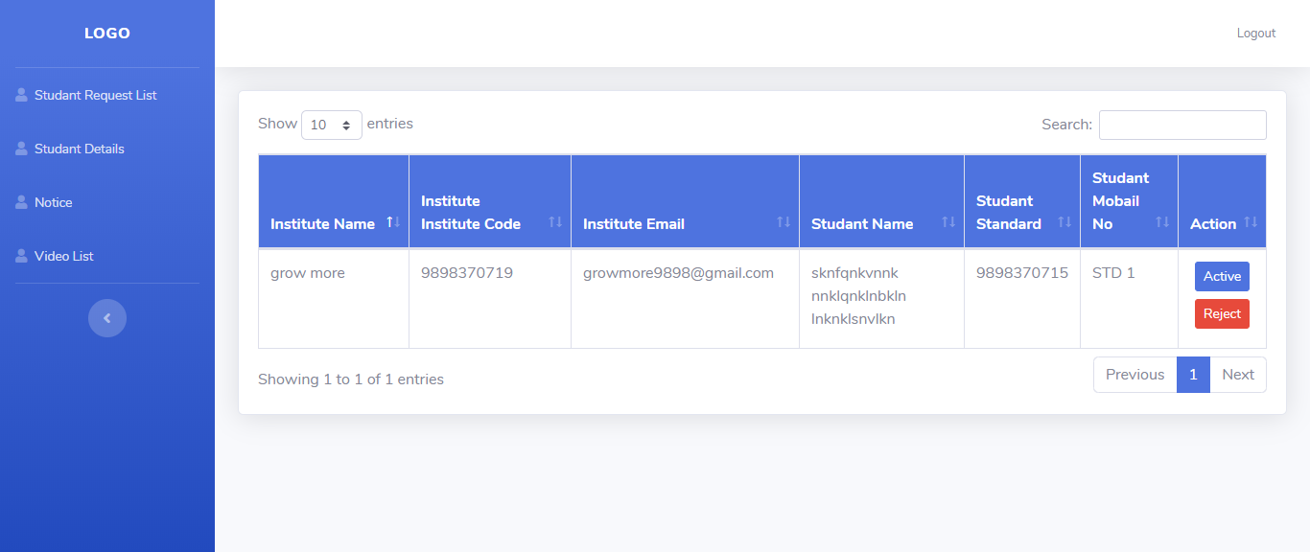
Student List (Active/Reject) -:
In institute Dashboard you can see list of the all students who request for join the institute.
Student only see the institute he added after institute approved this request.
If that student not belongs to that institute,institute can reject that student.

Slide 23
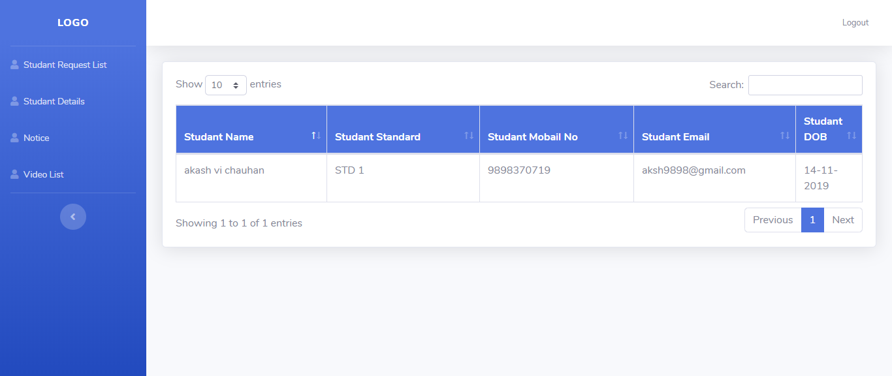
All Student Details -:
List of the all students which are active in that particular institute.
Here only you can see active institute.

Slide 24
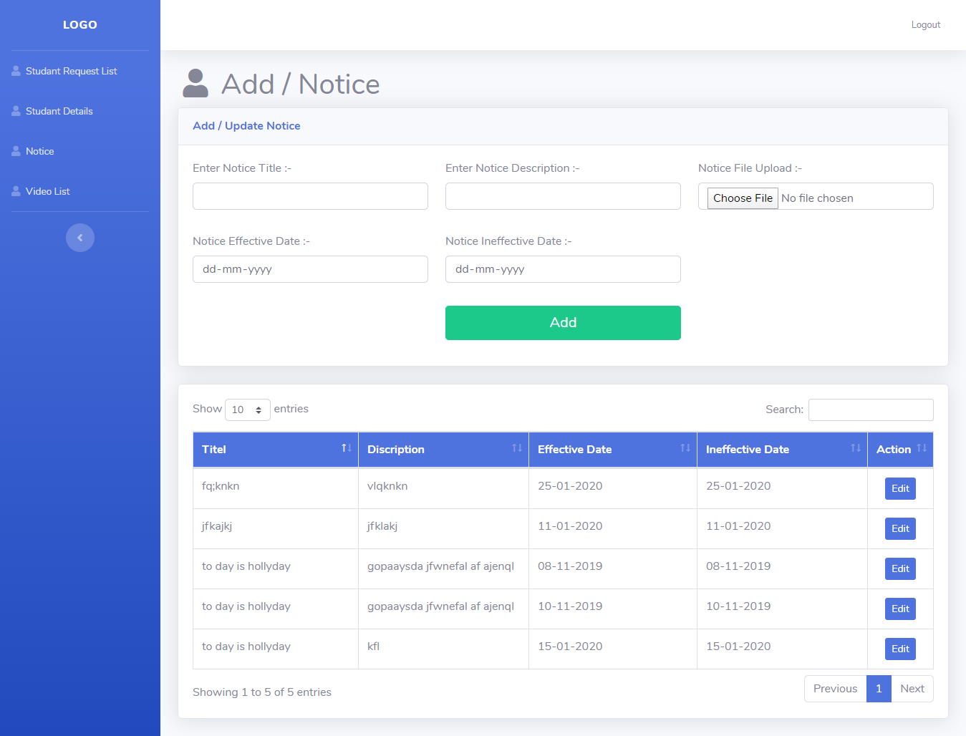
Institute Notice Add -:
This is master of notice.That perticular institute can add notice here.
You can see your institute notice only.

Slide 25
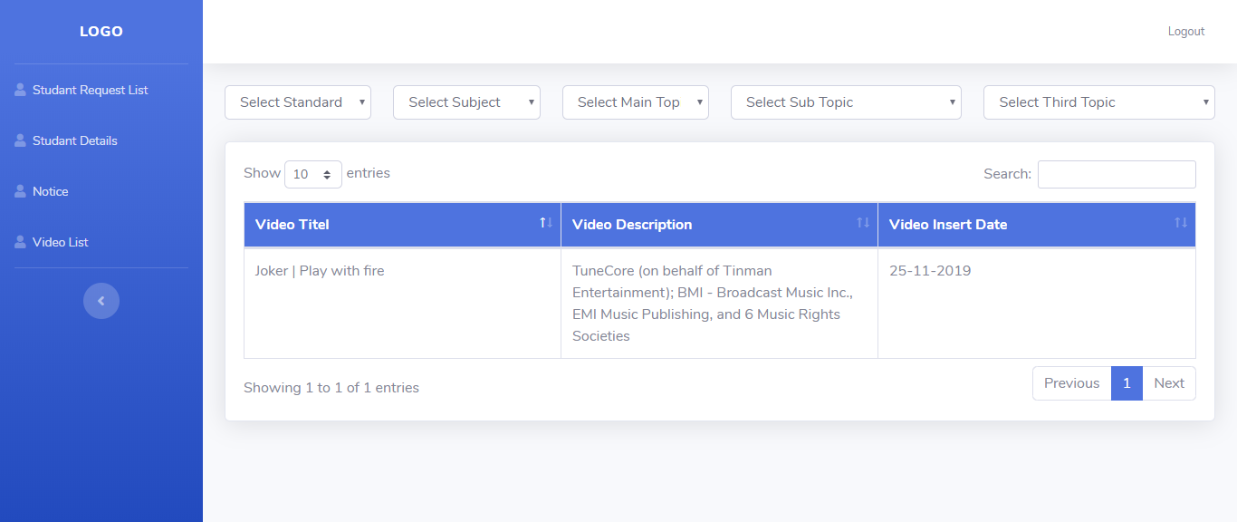
Institute Video List -:
From here institute can see his list of videos.
Only admin can add video institute can only see list of the videos.

Slide 26
Admin

Slide 27
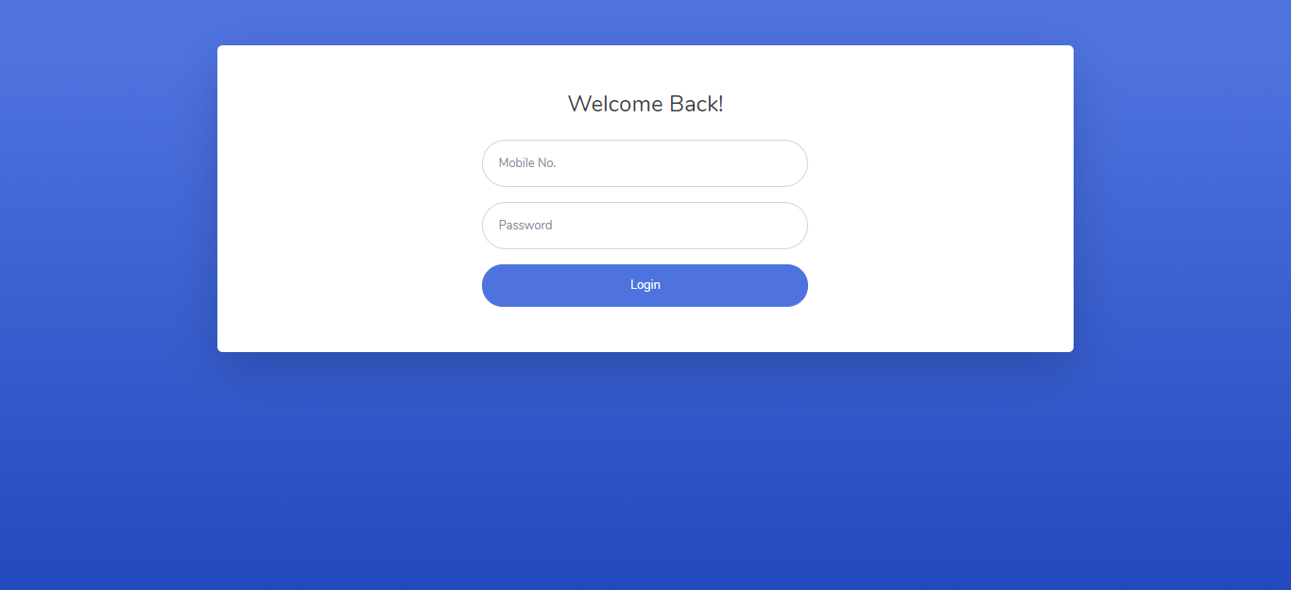
Login Page
Mo : 9874563210
Password : 1234

Slide 28
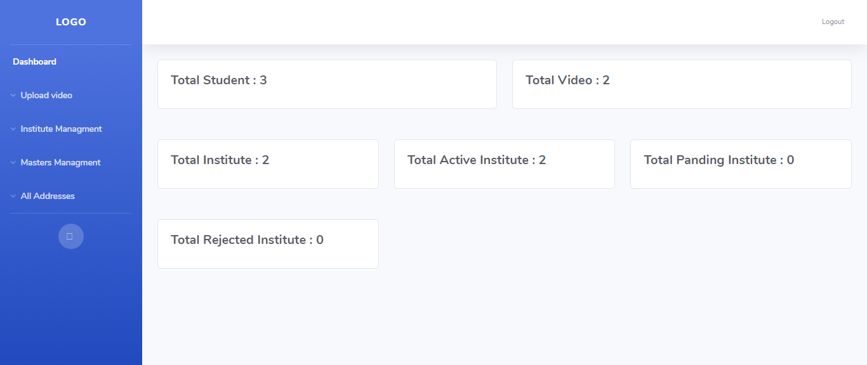
Admin Dashboard -:

Slide 29
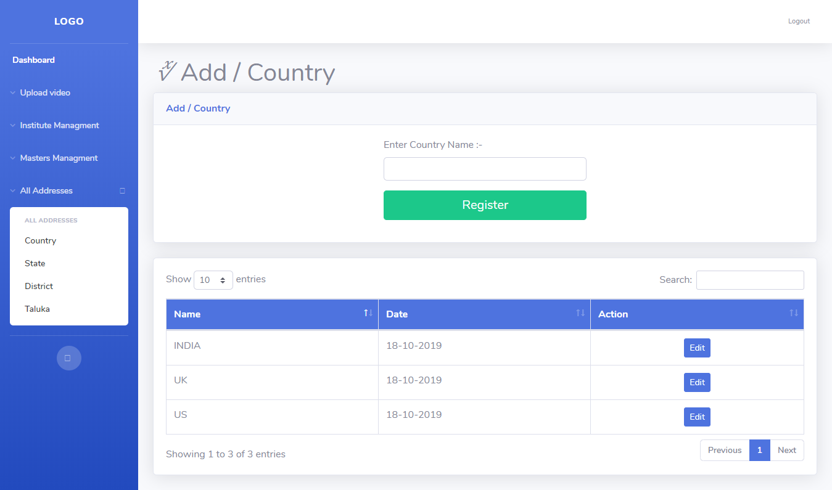
Add All Address -:

Slide 30
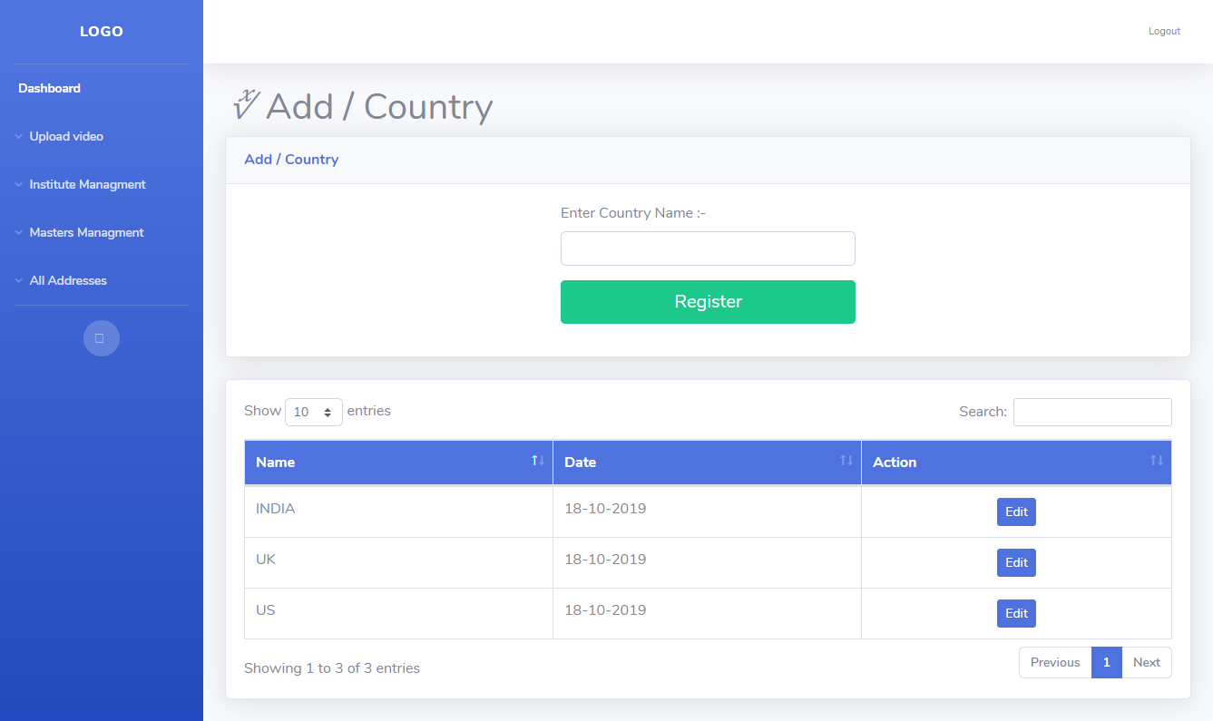
(1) Add Country -:

Slide 31
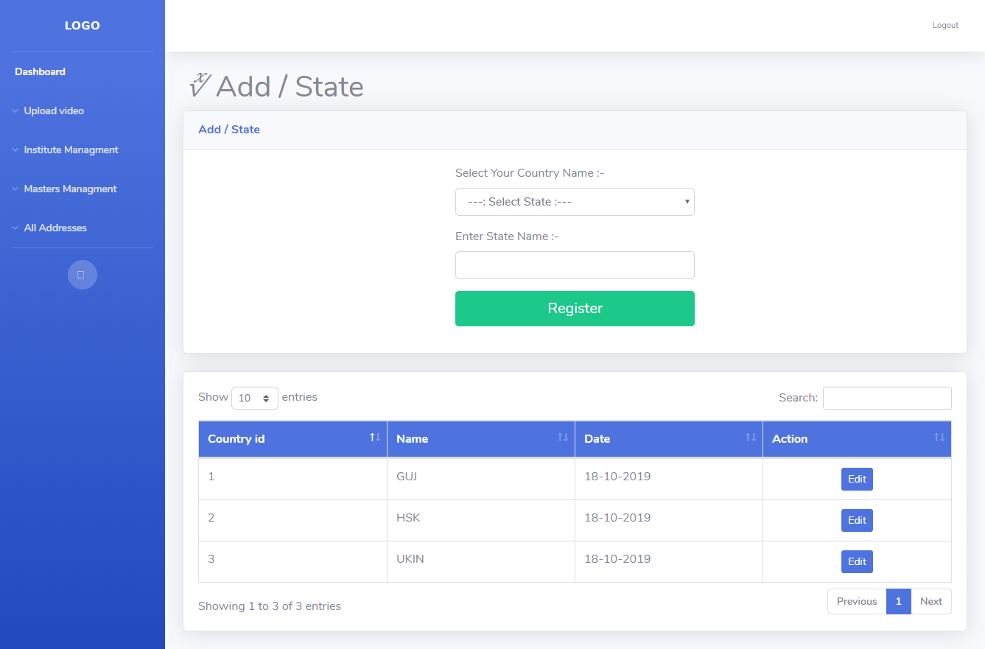
(2) Add State -:

Slide 32

(3) Add District -:

Slide 33

(4) Add Tehsil -:

Slide 34
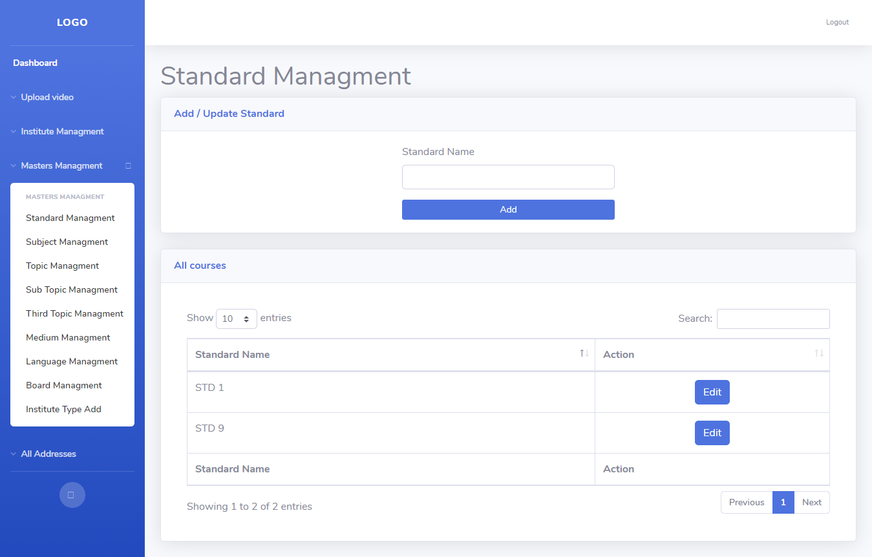
All Master Page -:

Slide 35
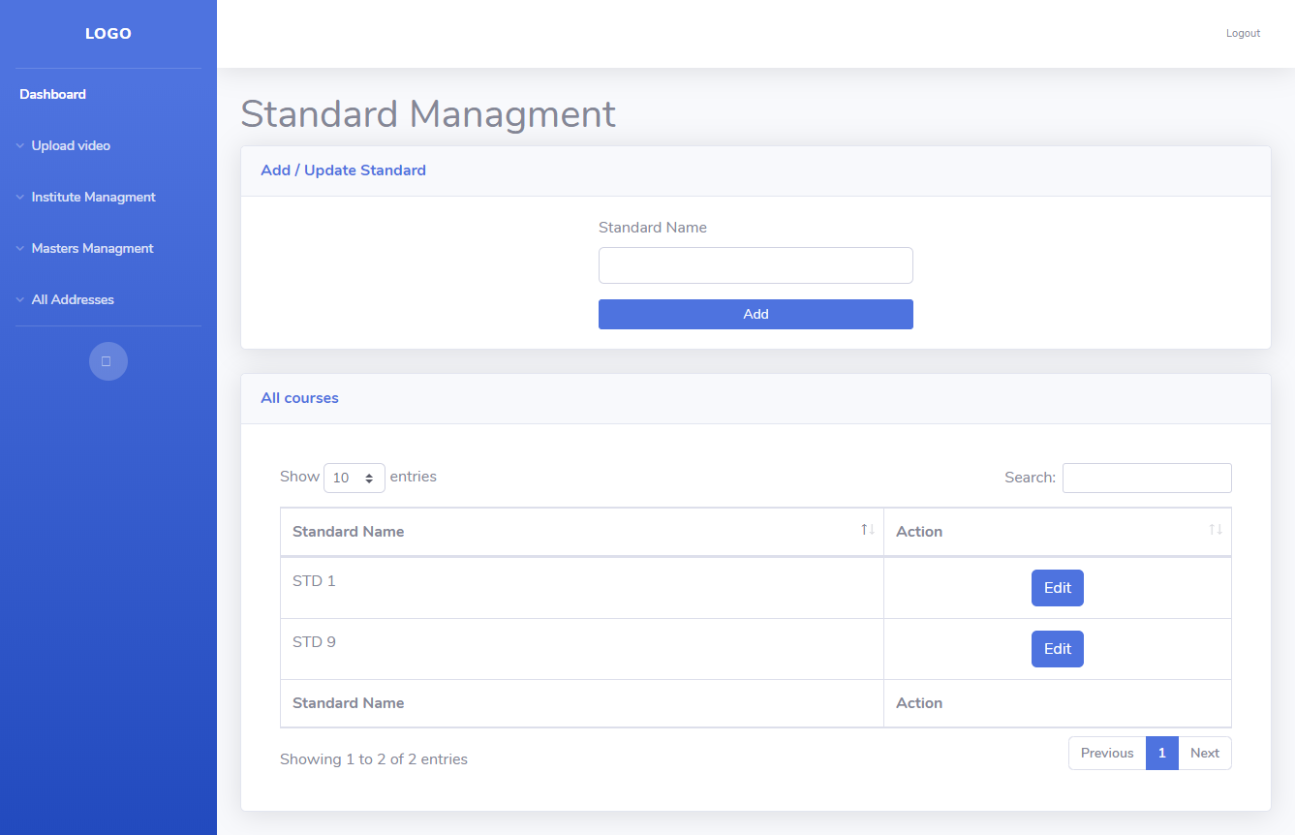
(1) Add/update Standard -:

Slide 36
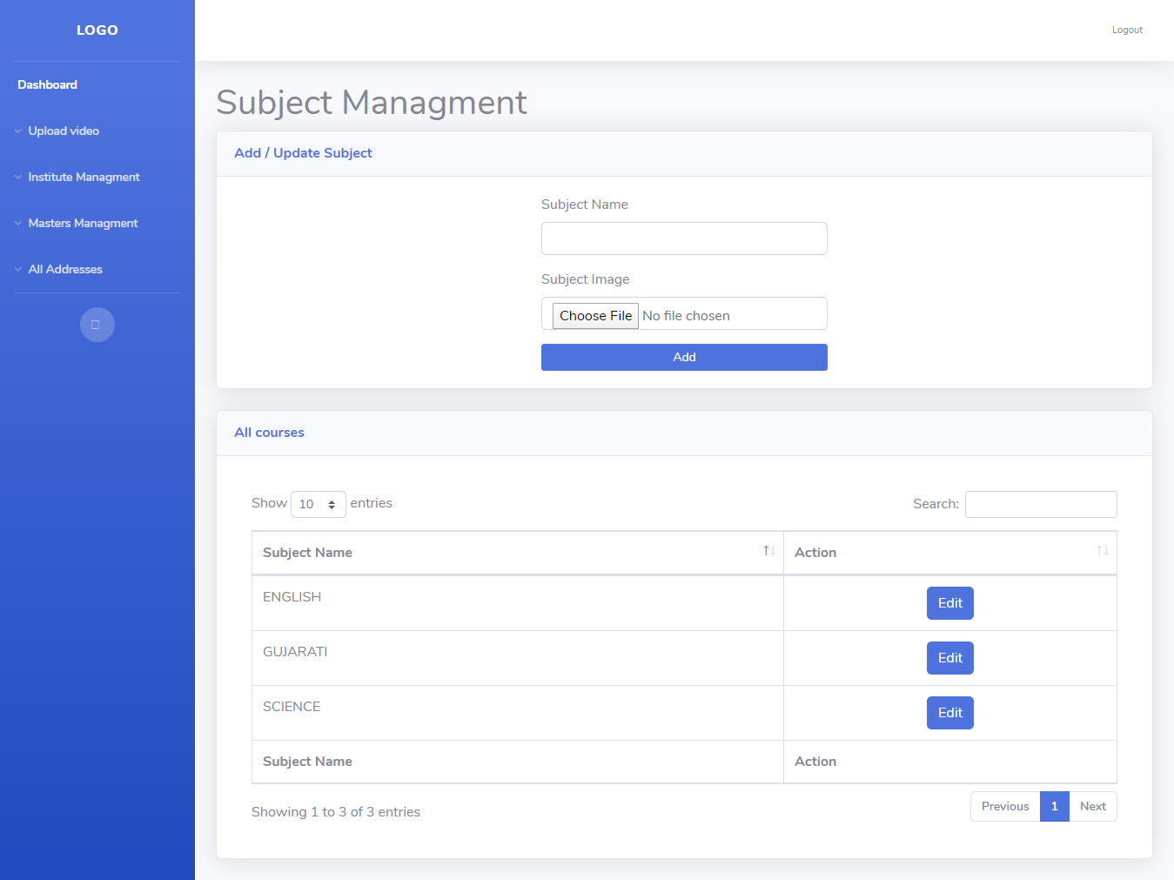
(2) Add/update Subject -:

Slide 37
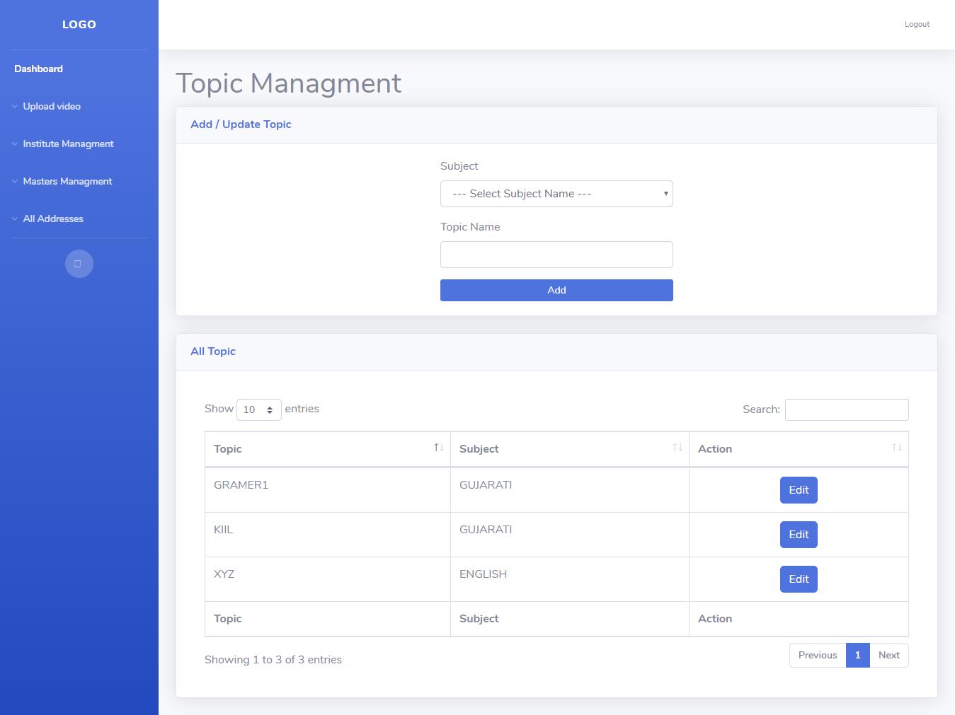
(3) Add /Update Topic -: (i) Add/Update First Topic -:

Slide 38
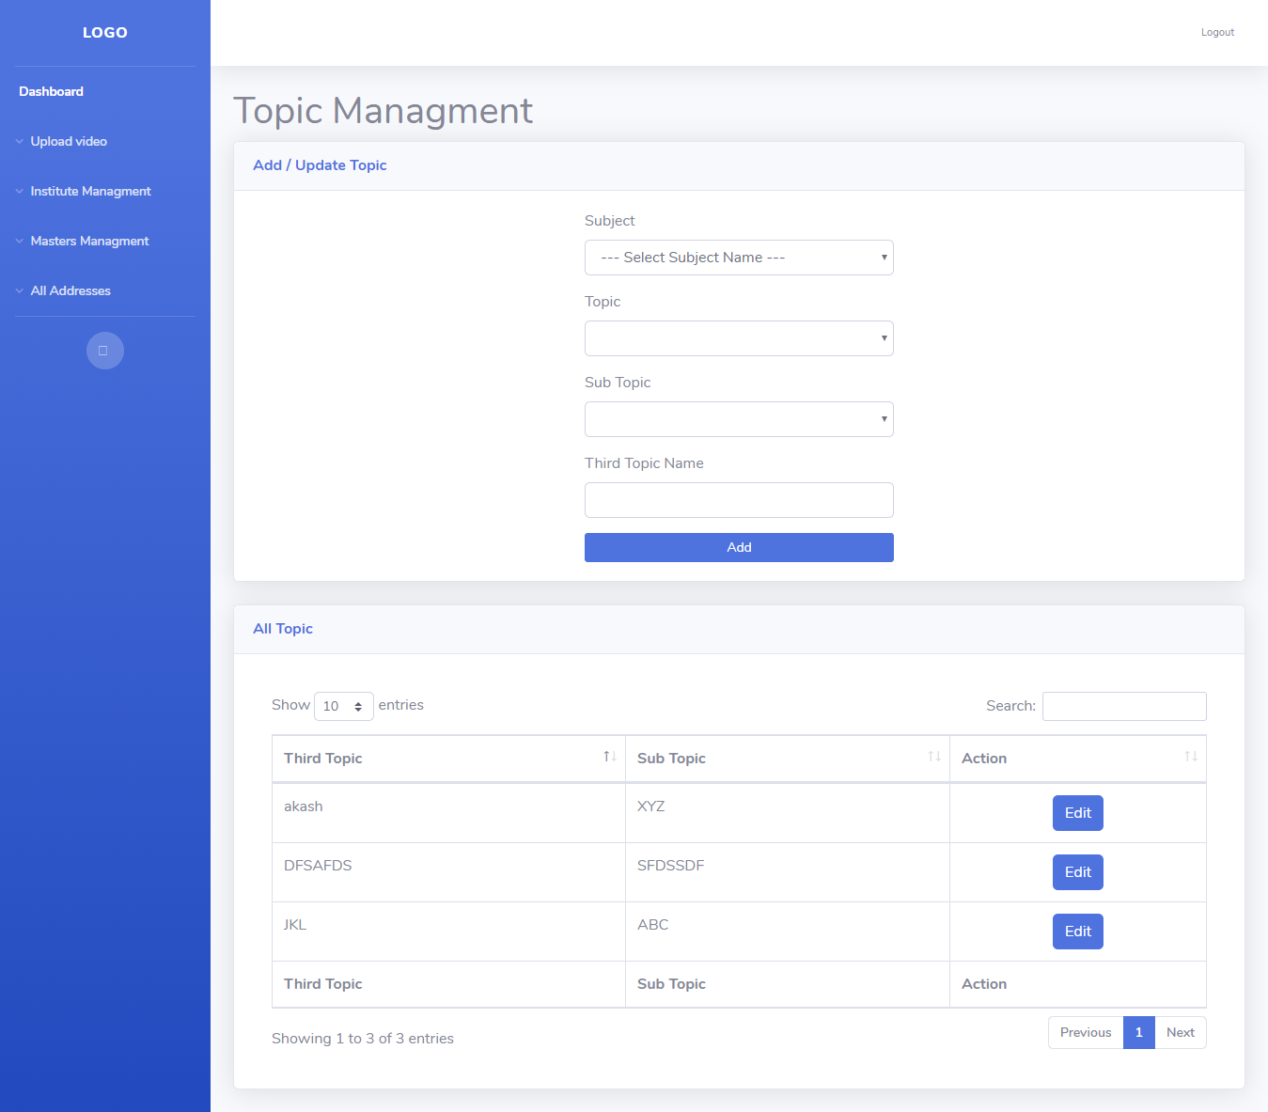
(ii) Add/update Sub Topic :-

Slide 39
(iii) Add/update Third Topic -:

Slide 40
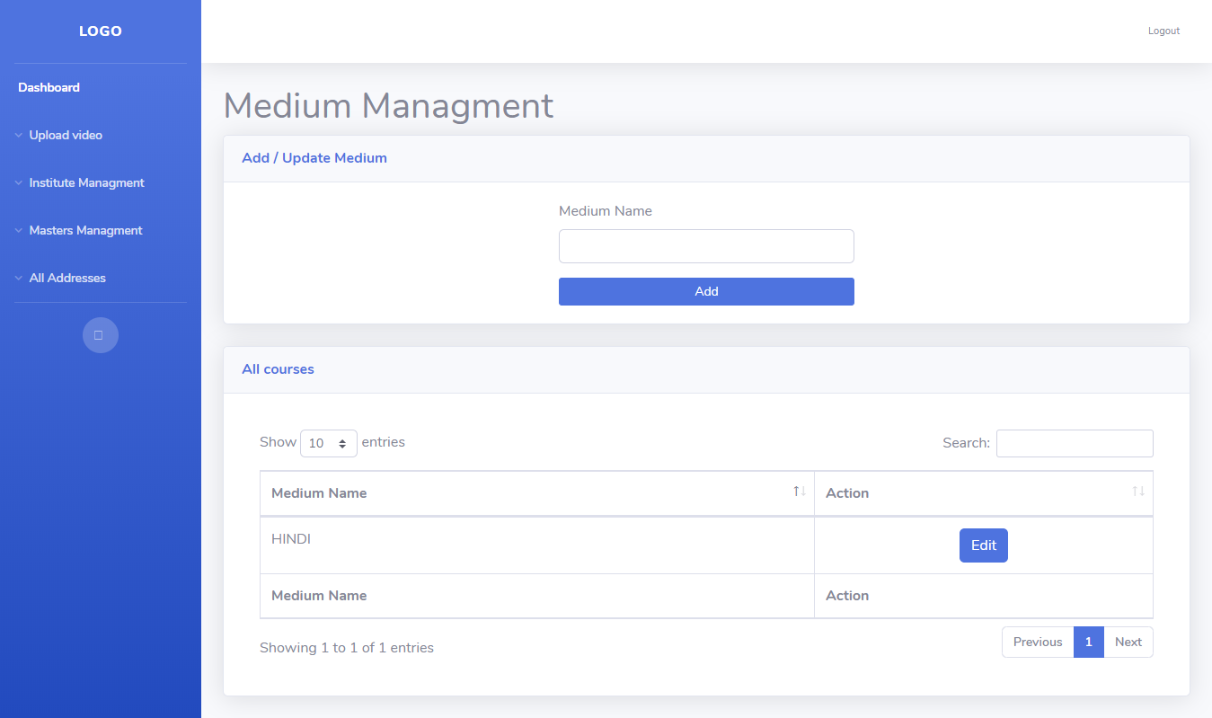
(4) Add /Update Medium -:

Slide 41
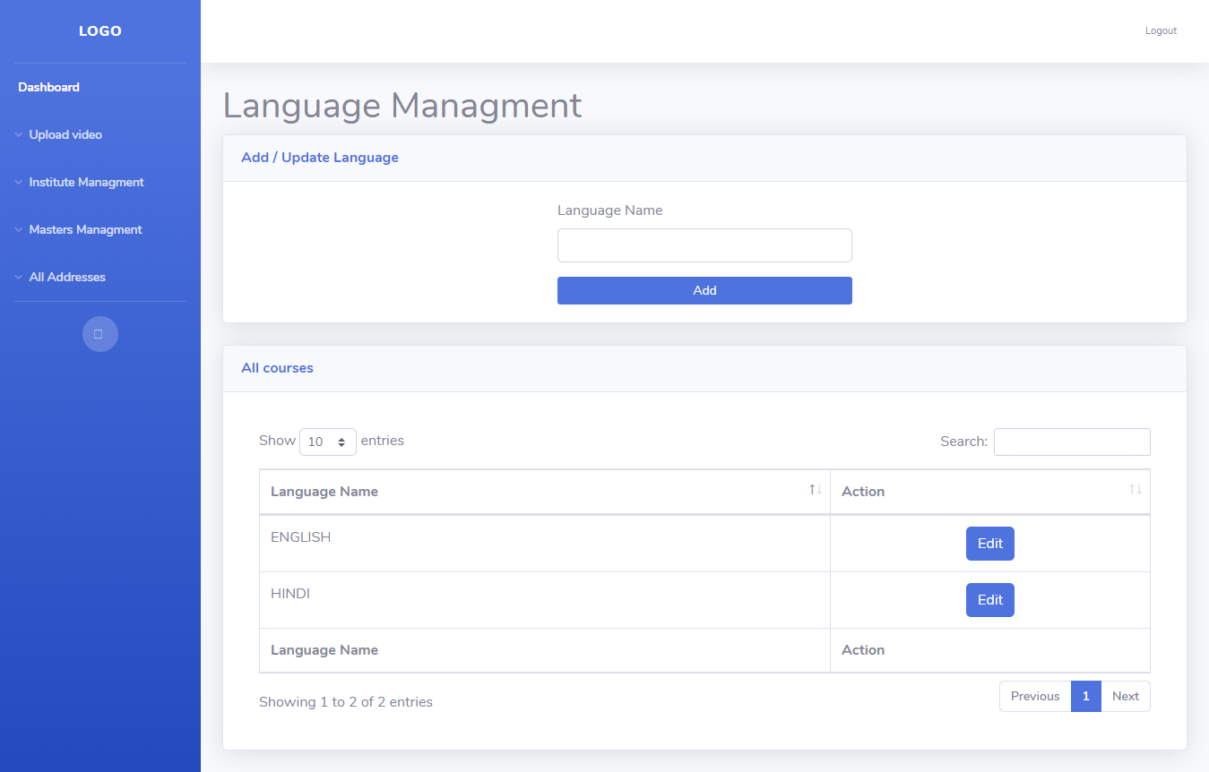
(5) Add /update Language -:

Slide 42
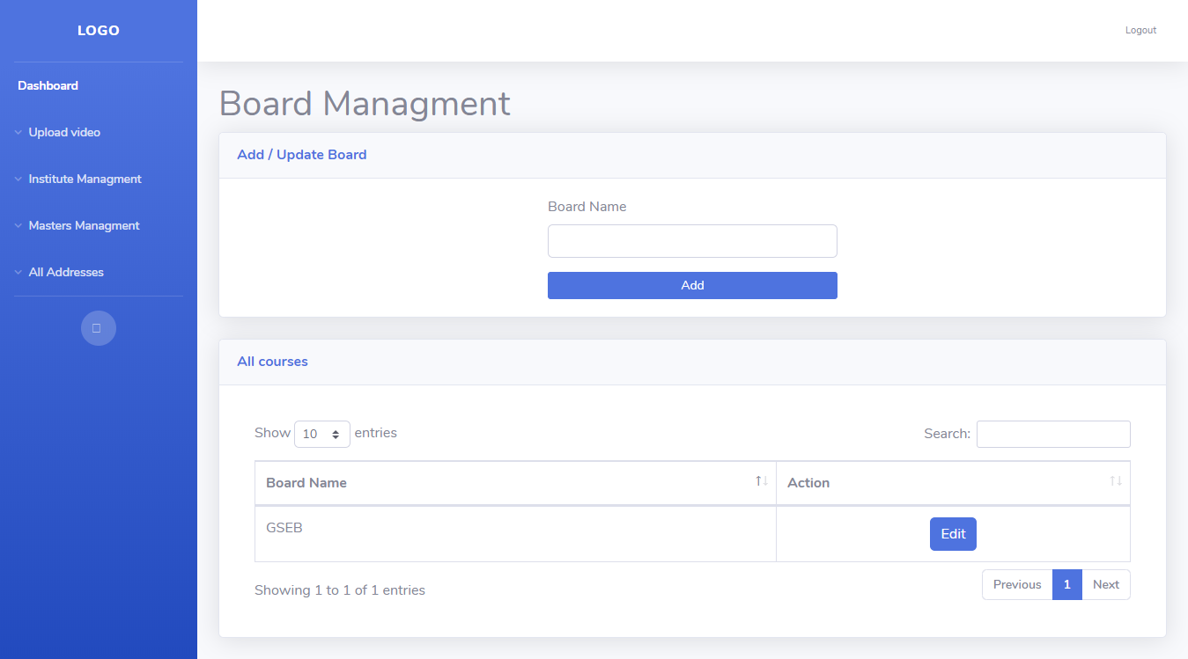
(6) Add /update Board -:

Slide 43
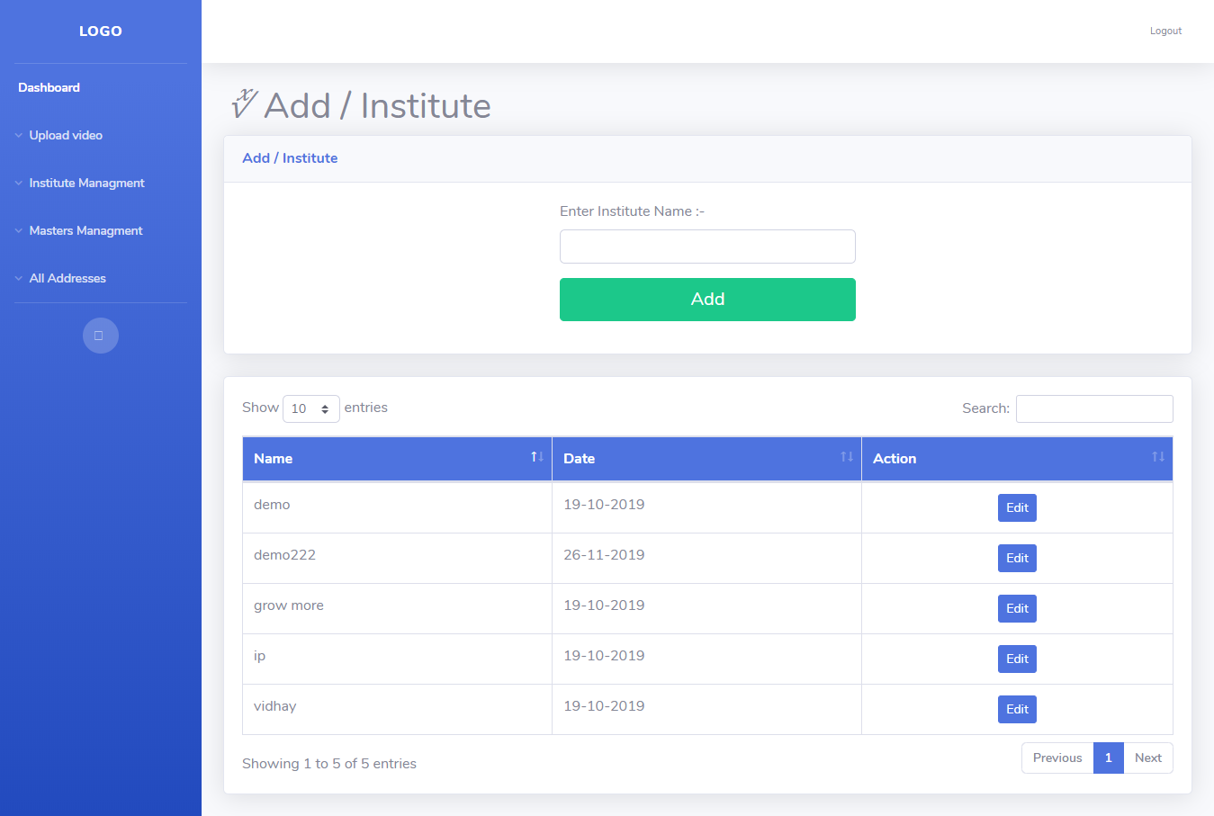
(6) Add /Update Institute Type -:

Slide 44
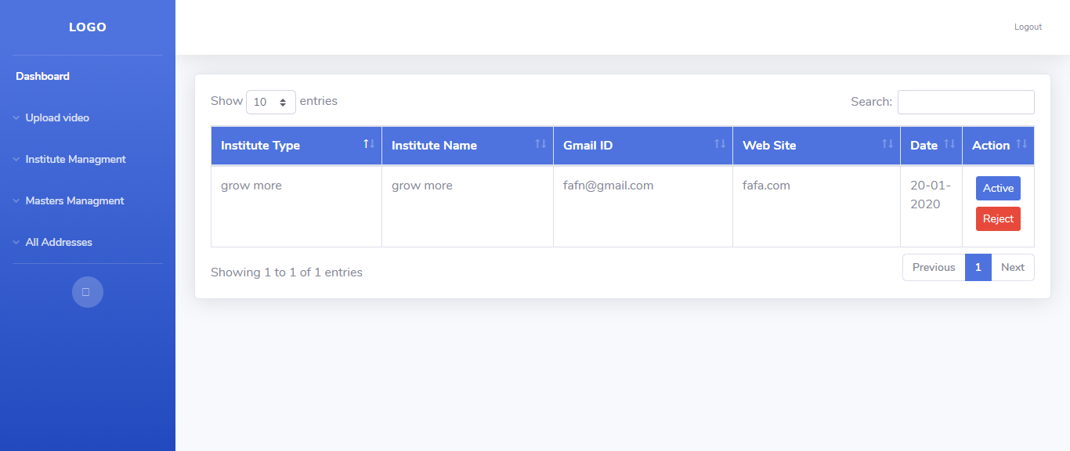
Institute Management -: (1) Active and Reject Institute -:
If you register as institute first admin approved you then and only you can login
And other student can see your institute.

Slide 45
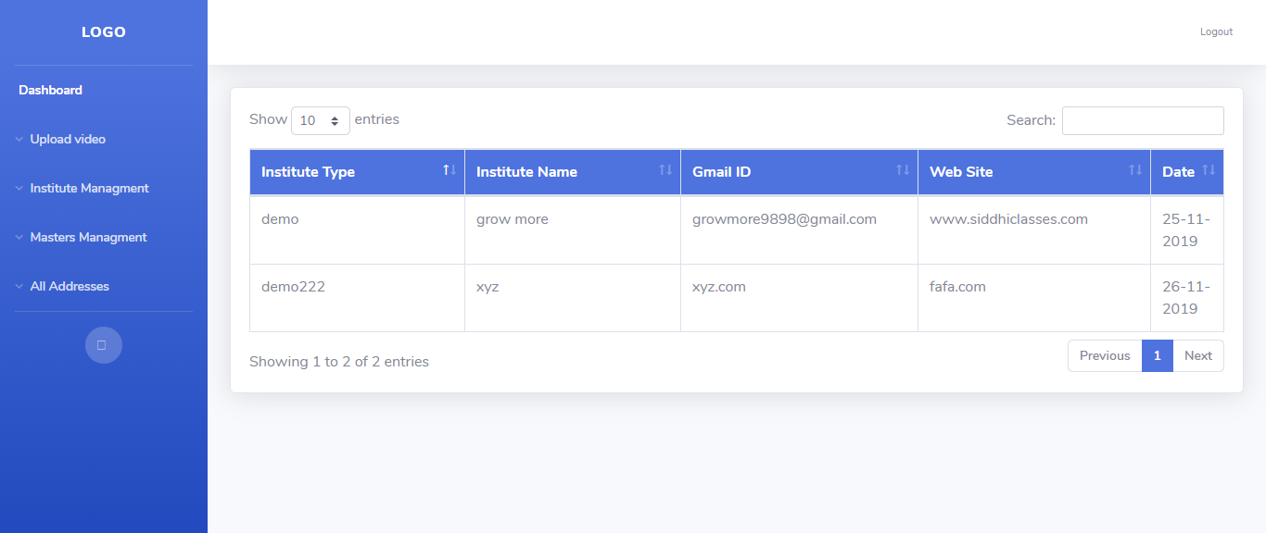
(2) List of Institutes -:

Slide 46
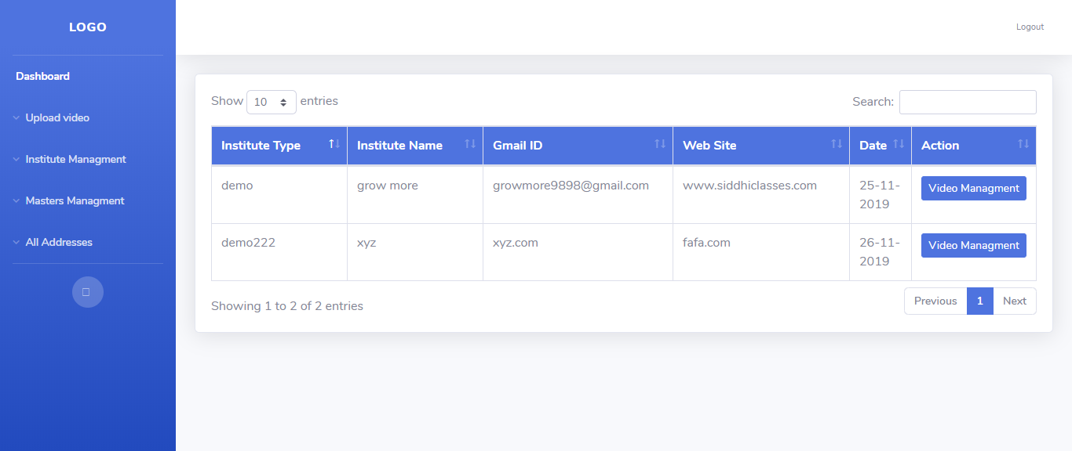
Institute List(Video Upload)-:

Slide 47
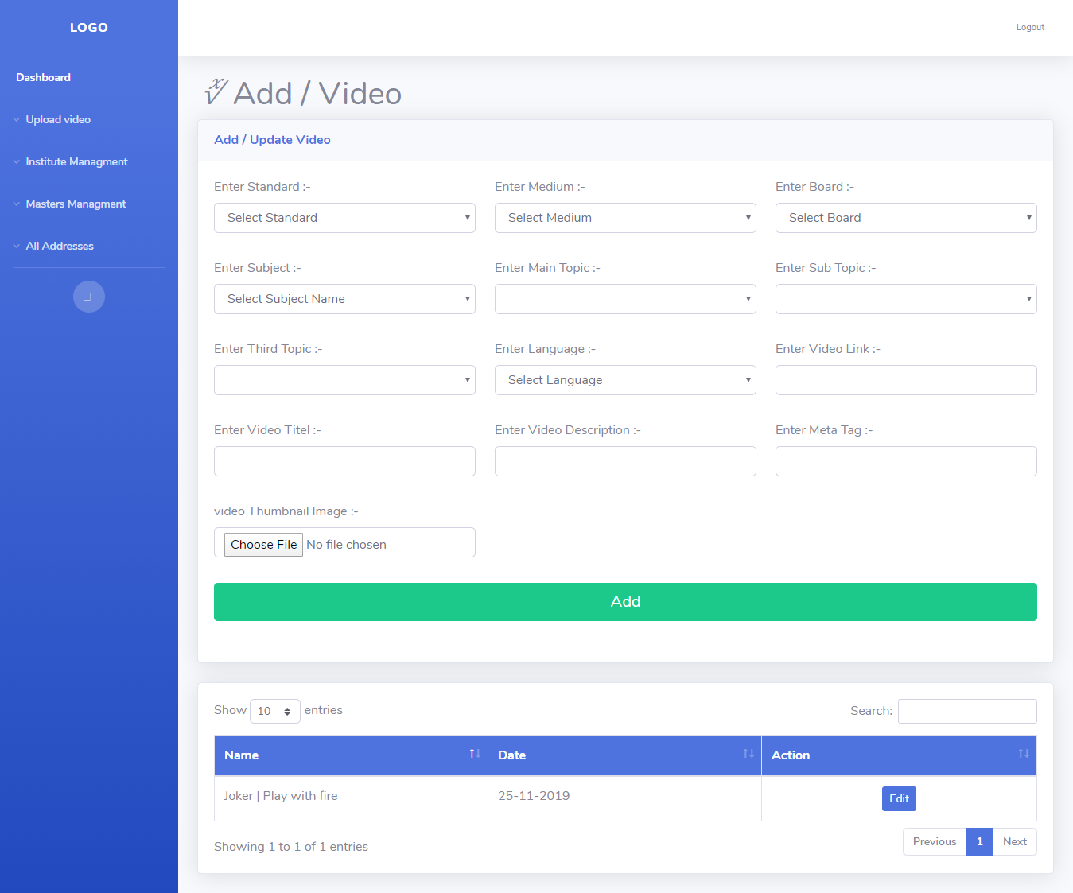
Video Add -:
After choosing any institute you as admin can upload any video for student and then
Student can see the videos.

